Slide 1

DATA SCIENCE
USING R

Slide 2


Slide 3
Big Data

Slide 4
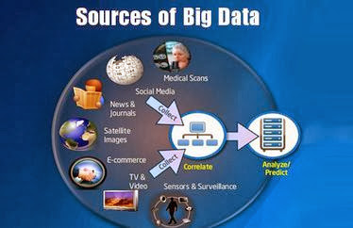

Slide 5

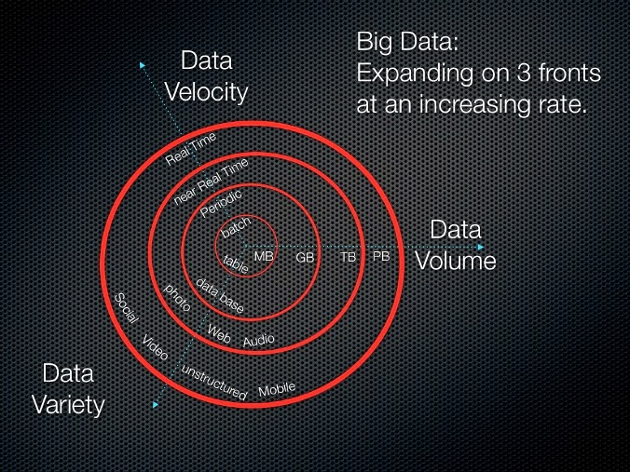
What is Big Data?
Used to describe large collections of data sets that can be unstructured and growing so large that can be difficult to manage by traditional databases.

Slide 6
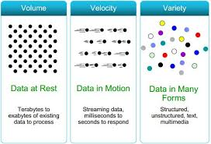
3 V’s of Big Data
3 V’s of
Big
Data
Volume
Velocity
Terabytes
Records
Transactions
Tables,Files
Batch
Near Time
Real Time
Streams
Variety
Structured
Unstructured
Semi structured
All of the above

Slide 7
Big Data Scenarios

Slide 8

Big Data Scenarios: Online Generated data
Generates stream of data that
can be analyzed.
Examples
Clicks
Transactions
Network messages
Play, fast forward, pause
Tweets, wall posts, friending
Mails, chats

Slide 9


Big Data Scenarios: Social Media
Emails
Photos
Videos
Chats
Phone Calls
Social Media

Slide 10
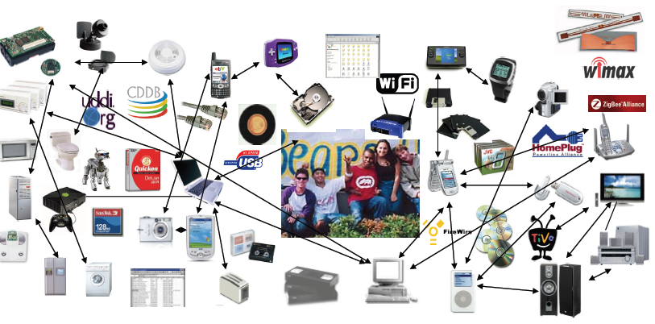
Big Data Scenarios: Machine Generated Data
Machines Operational data from sensors
Examples
1TB data/hour of flight
Terabytes from smart grids
Smart phones usage data

Slide 11
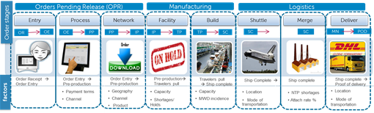


Big Data Scenarios: Machine Generated Data
Click Stream Data (navigation from product pages to placing order)
Order data (products, features, prices, billing)
Fulfillment data/ Services data

Slide 12

Big Data Scenarios: Graph Data
Graph analytics, also known as network analysis, is an exciting new area for analytics workloads.
Examples
Social Networks
Communication networks
Spread of infections
Collaborations & Relationships
Citations
Road networks

Slide 13
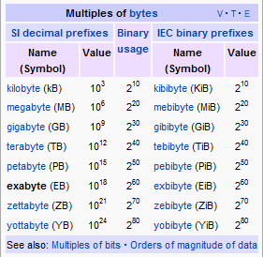
Measures of Data Volume

Slide 14
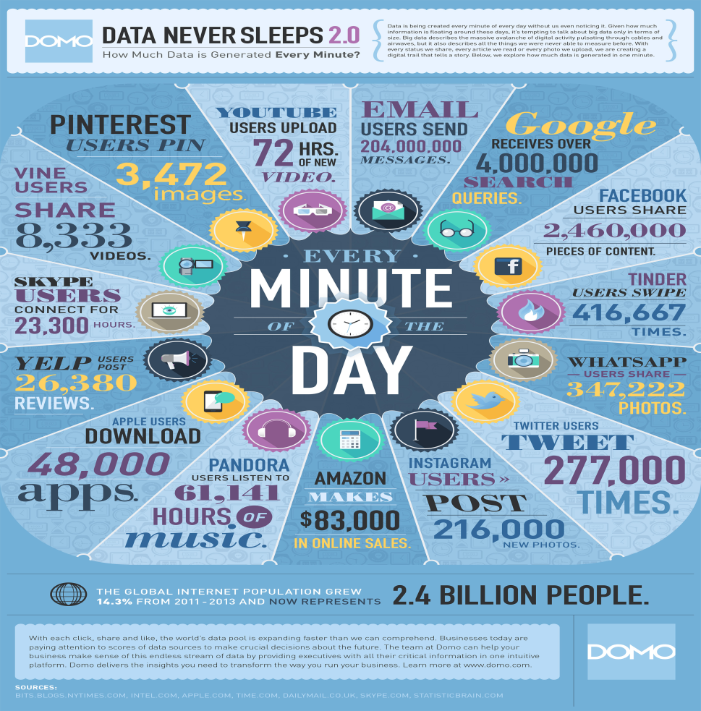
How much Data is generated?
Google processes 1000’s of PB/day, 48 hours of video uploaded every minute
Facebook has 100 PB and collects 500 TB/day
http://gigaom.com/data/facebook-is-collecting-your-data-500-terabytes-a-day/
eBay has 10 PB of user data + 100 TB/day
http://www.zdnet.com/au/how-ebay-uses-big-data-to-make-you-buy-more-7000006498/
CERN’s Large Hadron Collider (LHC) generates 25 PB a year

Slide 15
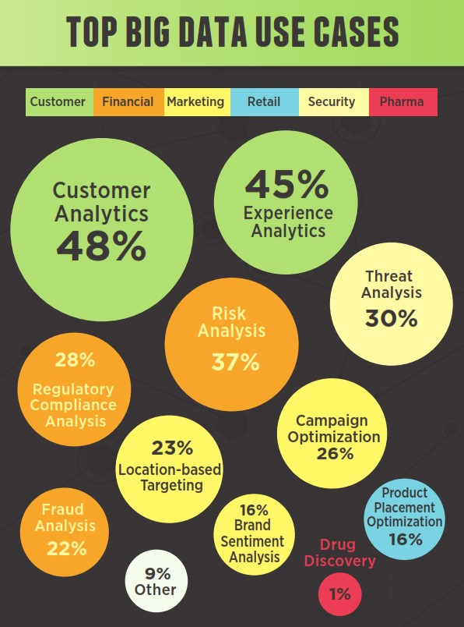

Slide 16





How is Big Data used?
Linked In
LinkedIn Uses Big Data to increase profile visibility and enhance professional brands
Amazon
Buyer preferences and recommendations from clicks data
Dunnhumby
Understand the product substitutes from petabytes of loyalty card data
Facebook
Who are the influencer’s and who are the followers
Boeing
Sensors data for likelihood of failure, real time vs. batch processing
Twitter
Customer Sentiment, Politicians gauging the interests of populations

Slide 17
How is Big Data used?...contd
Reports (E.g. Tracking business performance)
Diagnosis
Why is user engagement dropping
Why is system slow
Detect viruses, spam, worms etc.
Decision
Decide what features to add
Decide what ads to show
Block viruses, worms and spam

Slide 18
Introduction to
Data Analytics

Slide 19
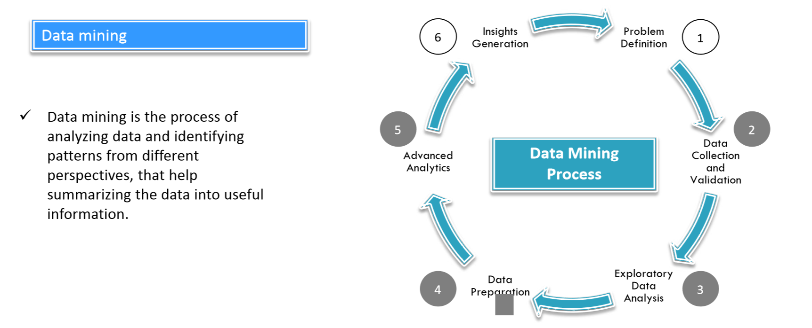
Introduction to Data Mining

Slide 20
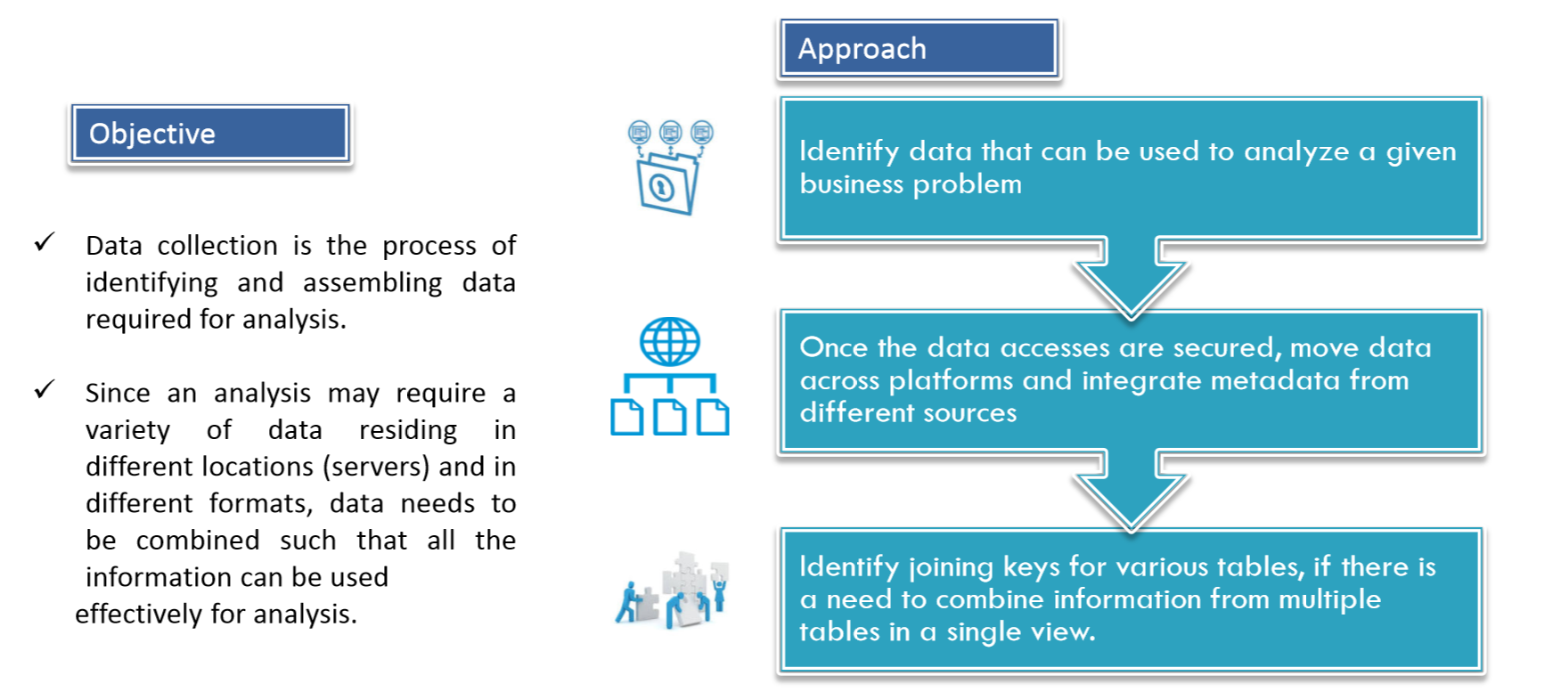
Data Collection

Slide 21
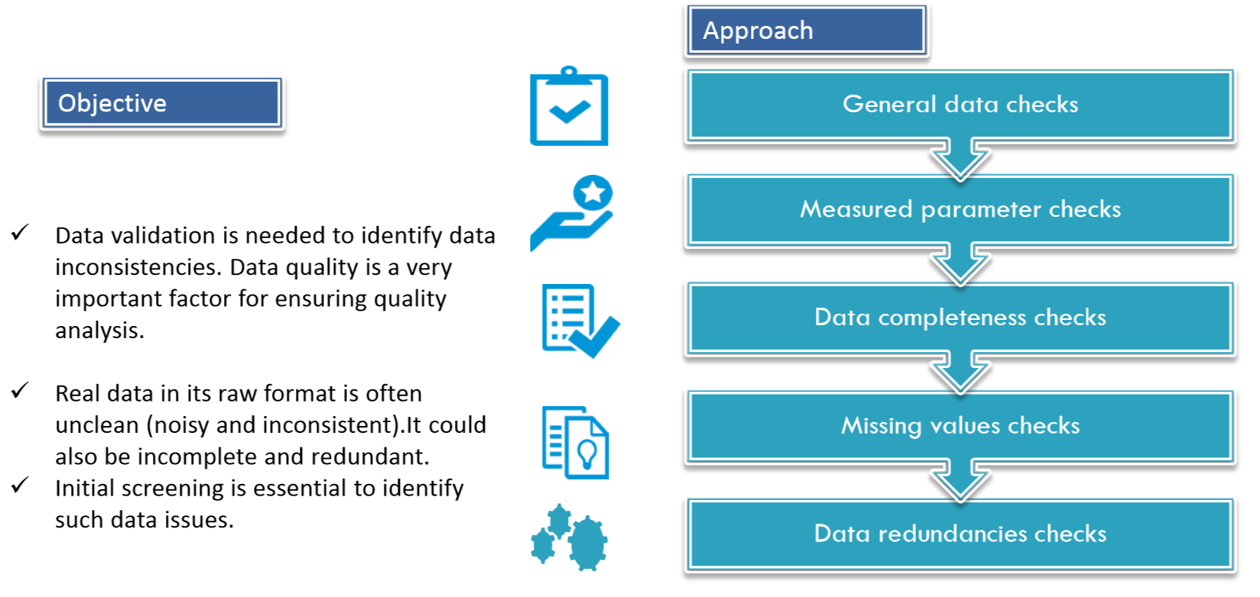
Data Validation

Slide 22
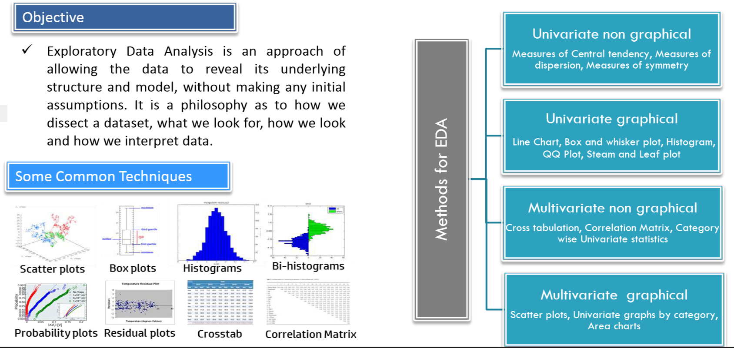
Exploratory Data Analysis (EDA)

Slide 23
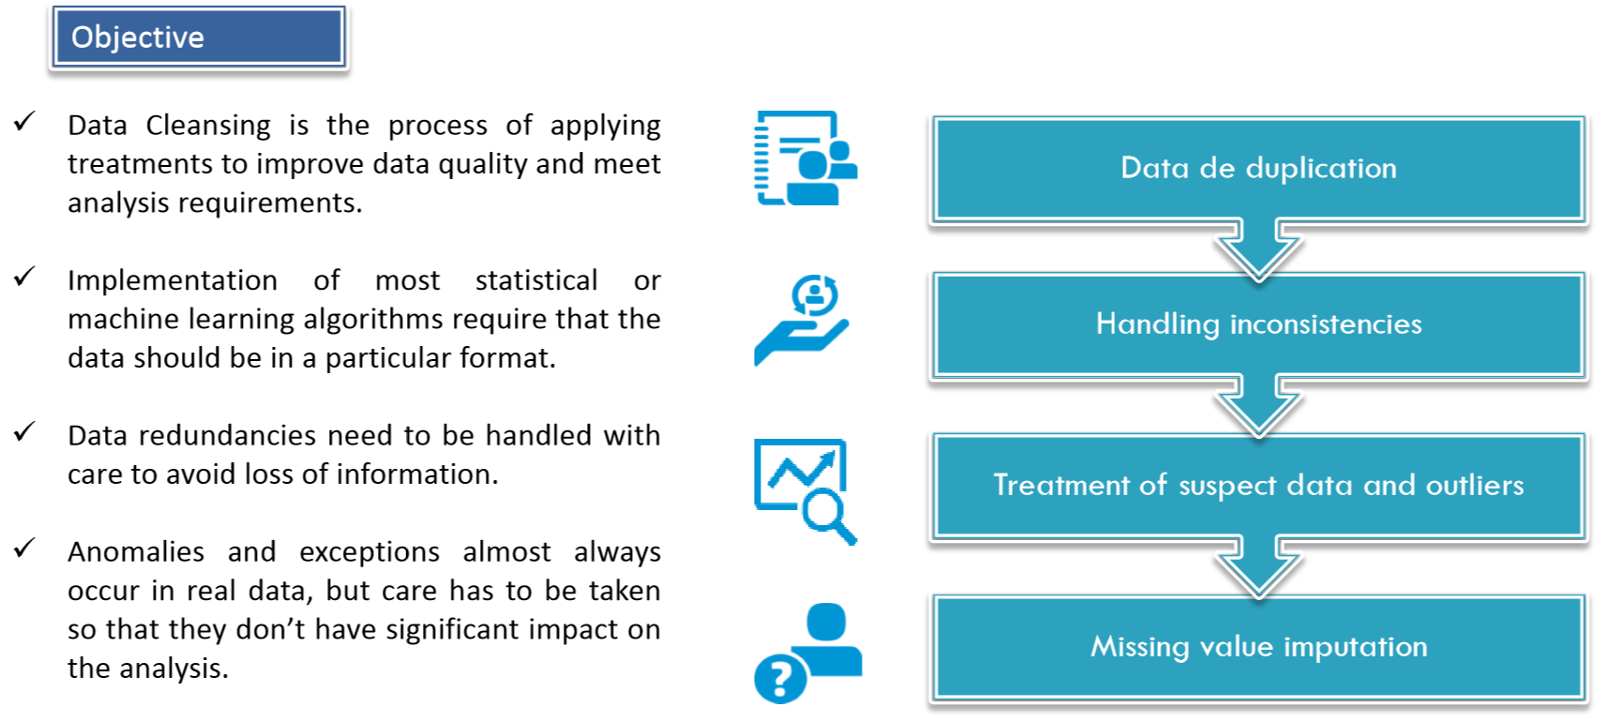
Data Cleaning

Slide 24
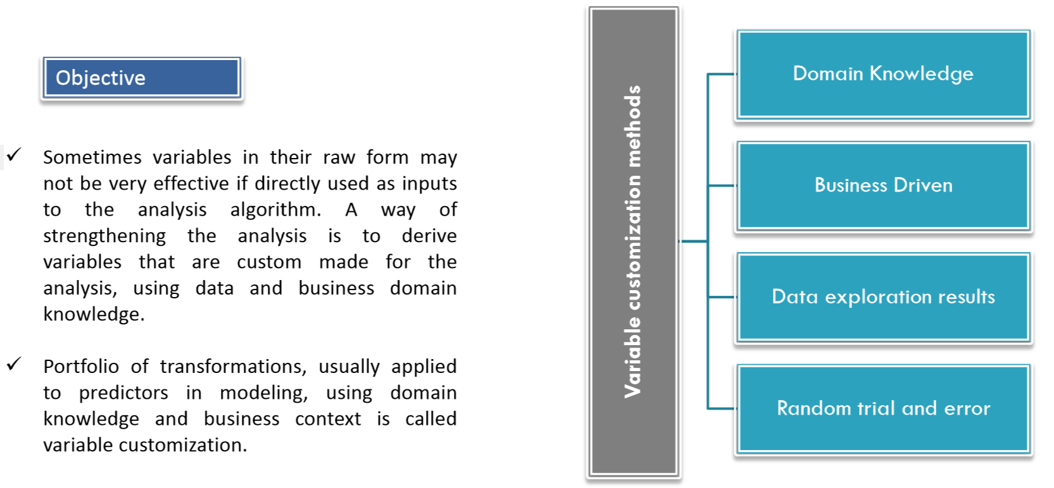
Variable Customization

Slide 25
Introduction to
R-Statistical Programming

Slide 27
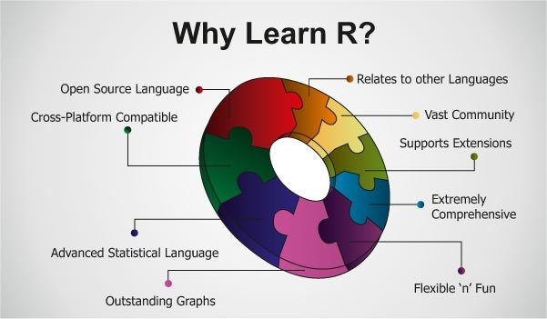

Slide 28
What is R?
R is one of the most powerful machine learning platforms and is used by the top data scientists in the world.
R is a language, an interpreter and a platform.
R is used by the best data scientists in the world.
R is powerful because of the breadth of techniques it oﬀers in third-party packages.
R is state-of-the-art because it is used by academics.
R is free because it is open source software.
R is a lot of fun.

Slide 29
What is R?
R is a computer language . It can be diﬃcult to learn but is familiar and you will ﬁgure it out quickly if you have used other scripting languages like Python, Ruby or BASH.
R is an interpreter . You can write scripts and save them as ﬁles. Like other scripting languages, you can then use the interpreter to run those scripts any time. R also provides a REPL environment where you can type in commands and see the output immediately.
R is also a platform . You can use it to create and display graphics, to save and load state and to interface with other systems. You can do all of your exploration and development in the REPL (read-evaluate-print loop) environment if you so wish.

Slide 30
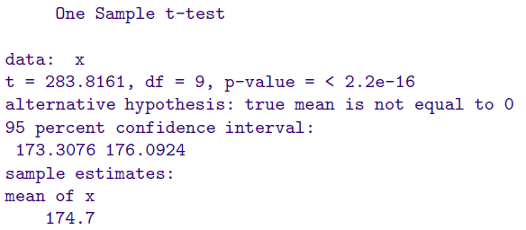
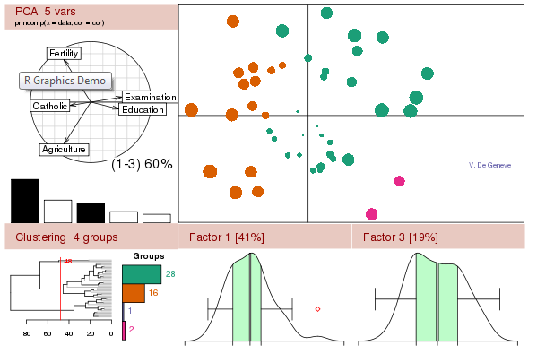
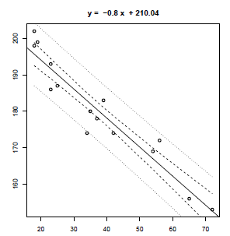
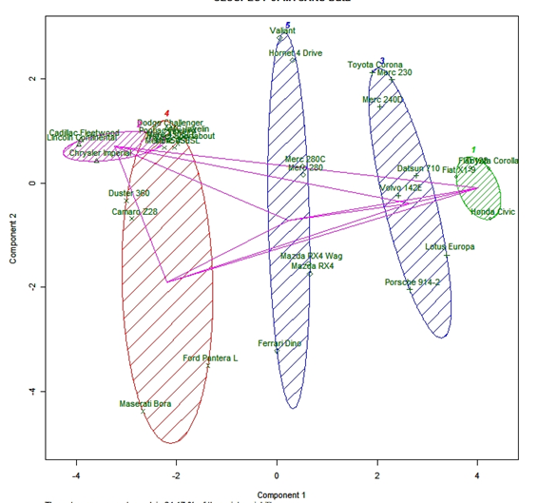
What is R – Statistics?
Hypothesis Testing
Powerful graphs using R
Linear Regression
Clustering

Slide 31
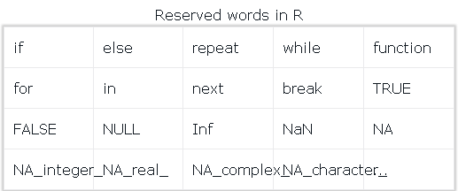
R Programming – Reserved keywords
Reserved words in R programming are a set of words that have special meaning and cannot be used as an identifier (variable name, function name etc).
Here is a list of reserved words in the R's parser.

Slide 32
R Programming – Reserved keywords
Among these words, if, else, repeat, while, function, for, in, next and break are used for conditions, loops and user defined functions. They form the basic building blocks of programming in R.
TRUE and FALSE are the logical constants in R.
NULL represents the absence of a value or an undefined value.
Inf is for "Infinity", for example when 1 is divided by 0 whereas NaN is for "Not a Number", for example when 0 is divided by 0.

Slide 33
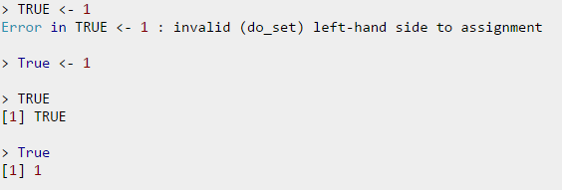
R Programming – Reserved keywords
NA stands for "Not Available" and is used to represent missing values.
R is a case sensitive language. Which mean that TRUE and True are not the same.
While the first one is a reserved word denoting a logical constant in R, the latter can be used a variable name.

Slide 34
R Programming – Variables in R
Variables are used to store data, whose value can be changed according to our need. Unique name given to variable (function and objects as well) is identifier.
Rules for writing Identifiers in R.
Identifiers can be a combination of letters, digits, period (.) and underscore (_).
It must start with a letter or a period. If it starts with a period, it cannot be followed by a digit.
Reserved words in R cannot be used as identifiers.
Valid identifiers in R
total, Sum, .fine.with.dot, this_is_acceptable, Number5
Invalid identifiers in R
tot@l, 5um, _fine, TRUE, .0ne

Slide 35
R Programming – R Operators
R has many operators to carry out different mathematical and logical operations.
Operators in R can mainly be classified into the following categories.
Type of operators in R
Arithmetic operators
Relational operators
Logical operators
Assignment operators
R Arithmetic Operators
These operators are used to carry out mathematical operations like addition and multiplication. Here is a list of arithmetic operators available in R.

Slide 36
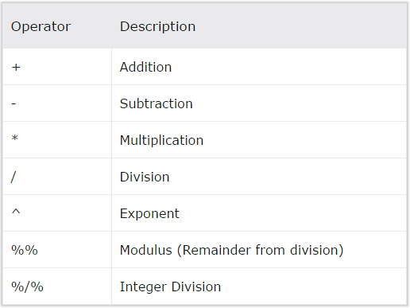
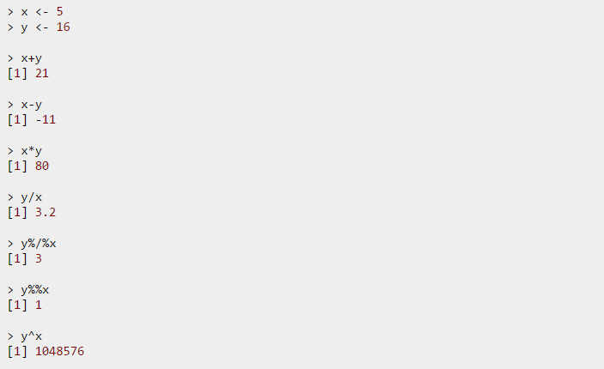
R Programming – R Operators

Slide 37
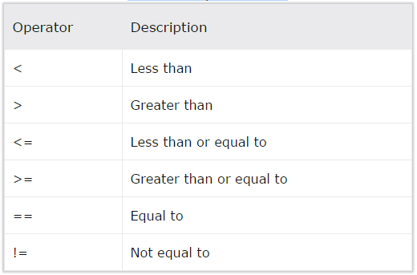
R Programming – R Relational Operators
Relational operators are used to compare between values. Here is a list of relational operators available in R.
Relational Operators in R

Slide 38
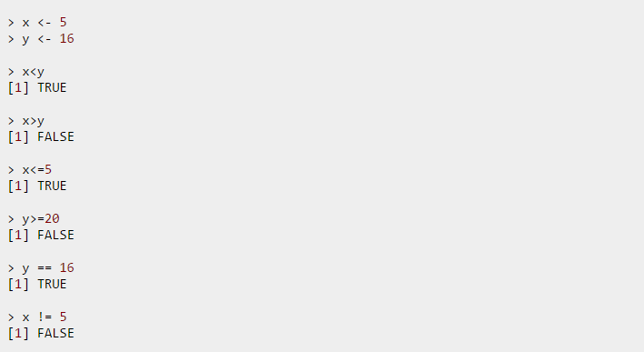
R Programming – R Relational Operators
Example

Slide 39
R Programming – R Vectors
Vector is a basic data structure in R. It contains element of the same type. The data types can be logical, integer, double, character, complex or raw.
A vector's type can be checked with the typeof() function.
Another important property of a vector is its length. This is the number of elements in the vector and can be checked with the function length().
How to create a Vector in R programming?
Vectors are generally created using the c() function.
Since, a vector must have elements of the same type, this function will try and coerce elements to the same type, if they are different.

Slide 40
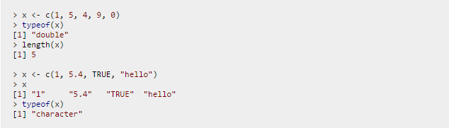
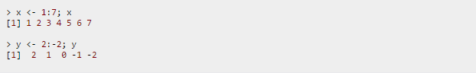
R Programming – Operation on Vectors
Coercion is from lower to higher types from logical to integer to double to character.
If we want to create a vector of consecutive numbers, the : operator is very helpful.
Example 1: Creating a vector using : operator
More complex sequences can be created using the seq() function, like defining number of points in an interval, or the step size.

Slide 41
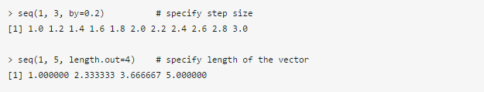
R Programming – Operation on Vectors
Example 2: Creating a vector using seq() function
How to access Elements of a Vector?
Elements of a vector can be accessed using vector indexing. The vector used for indexing can be logical, integer or character vector.

Slide 42
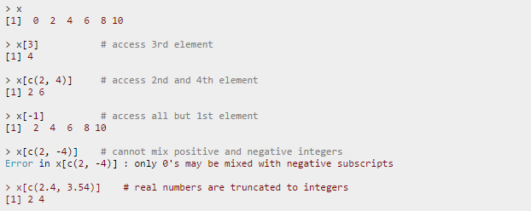
R Programming – Operation on Vectors
Using integer vector as index
Vector index in R starts from 1, unlike most programming languages where index start from 0.
We can use a vector of integers as index to access specific elements.
We can also use negative integers to return all elements except that those specified.
But we cannot mix positive and negative integers while indexing and real numbers, if used, are truncated to integers.

Slide 43
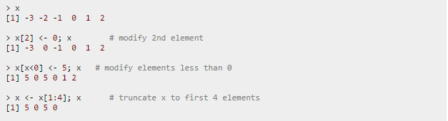
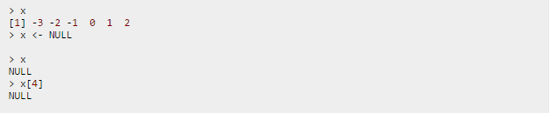
R Programming – Operation on Vectors
How to modify a vector in R?
We can modify a vector using the assignment operator.
We can use the techniques discussed above to access specific elements and modify them.
If we want to truncate the elements, we can use reassignments.
How to delete a Vector?
We can delete a vector by simply assigning a NULL to it.

Slide 44
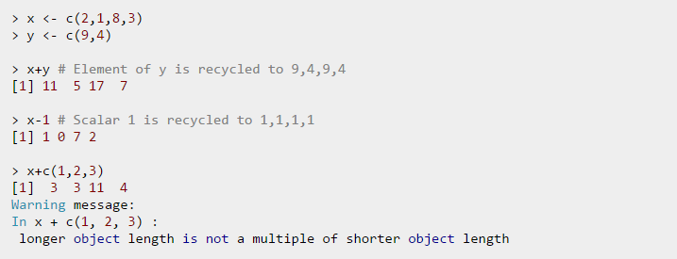
R Programming – Operation on Vectors
When there is a mismatch in length (number of elements) of operand vectors, the elements in shorter one is recycled in a cyclic manner to match the length of the longer one.
R will issue a warning if the length of the longer vector is not an integral multiple of the shorter vector.

Slide 45
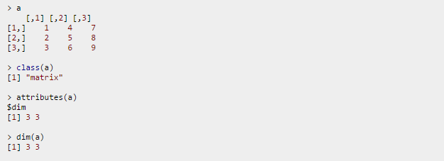
R Programming – R Matrix
Matrix is a two dimensional data structure in R programming.
Matrix is similar to vectors but additionally contains the dimension attribute. All attributes of an object can be checked with the attributes() function (dimension can be checked directly with the dim() function).
We can check if a variable is a matrix or not with the class() function.
Let us consider a matrix as follows.

Slide 46
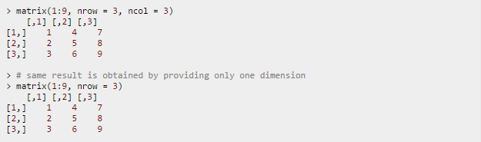
R Programming – R Matrix
How to create a matrix in R programming?
Matrix can be created using the matrix() function.
Dimension of the matrix can be defined by passing appropriate value for arguments nrow and ncol.
Providing value for both dimension is not necessary. If one of the dimension is provided, the other is inferred from length of the data.

Slide 47
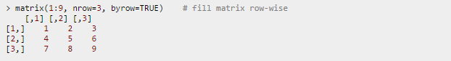
R Programming – R Matrix
We can see that the matrix is filled column-wise. This can be reversed to row-wise filling by passing TRUE to the argument byrow.
We can see that the matrix is filled column-wise. This can be reversed to row-wise filling by passing TRUE to the argument byrow.

Slide 48
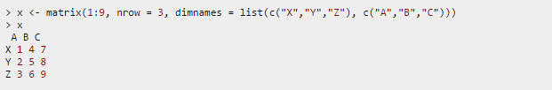
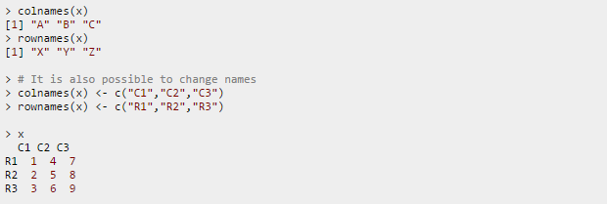
R Programming – R Matrix
In all cases, however, a matrix is stored in column-major order internally as we will see in the subsequent sections.
It is possible to name the rows and columns of matrix during creation by passing a 2 element list to the argument dimnames.
These names can be accessed or changed with two helpful functions colnames() and rownames().

Slide 49
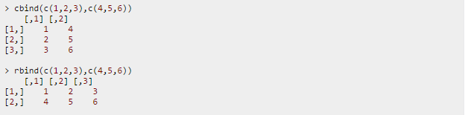
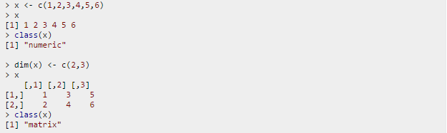
R Programming – R Matrix
Another way of creating a matrix is by using functions cbind() and rbind() as in column bind and row bind.
Finally, you can also create a matrix from a vector by setting its dimension using dim().

Slide 50
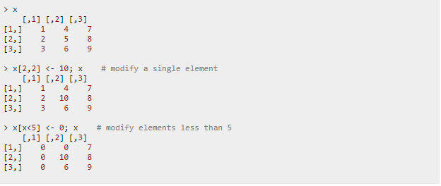
R Programming – R Matrix
How to access Elements of a matrix?
We can access elements of a matrix using the square bracket [ indexing method. Elements can be accessed as var[row, column]. Here rows and columns are vectors.
How to modify a matrix in R?
We can combine assignment operator with the above learned methods for accessing elements of a matrix to modify it.

Slide 51
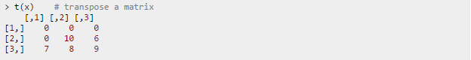
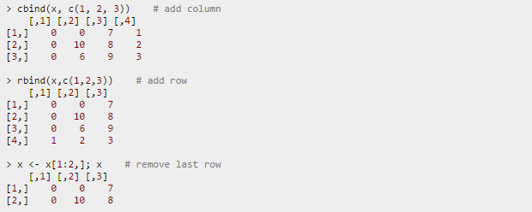
R Programming – R Matrix
A common operation with matrix is to transpose it. This can be done with the function t().
We can add row or column using rbind() and cbind() function respectively. Similarly, it can be removed through reassignment.

Slide 52
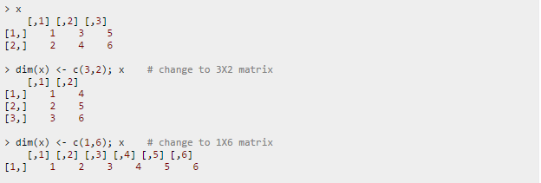
R Programming – R Matrix
Dimension of matrix can be modified as well, using the dim() function.

Slide 53
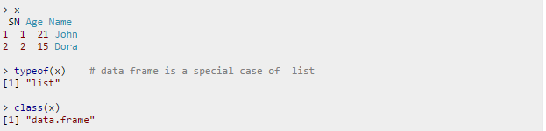
R Programming – R Data Frame
Data frame is a two dimensional data structure in R. It is a special case of a list which has each component of equal length.
Each component form the column and contents of the component form the rows.
Check if a variable is a data frame using class()
We can check if a variable is a data frame or not using the class() function.
In this example, x can be considered as a list of 3 components with each component having a two element vector. Some useful functions to know more about a data frame are given below.

Slide 54
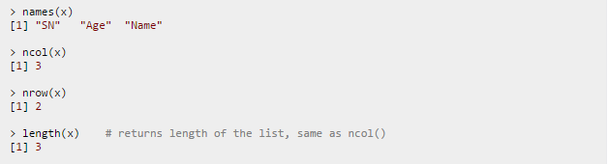
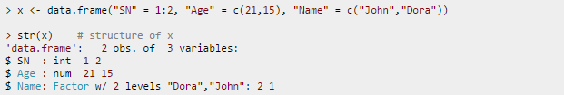
R Programming – R Data Frame
Functions of data frame
How to create a Data Frame in R?
We can create a data frame using the data.frame() function.
For example, the above shown data frame can be created as follows.

Slide 55
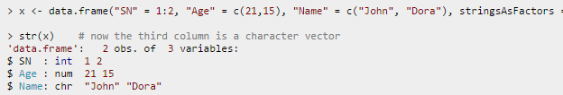
R Programming – R Data Frame
Notice above that the third column, Name is of type factor, instead of a character vector.
By default, data.frame() function converts character vector into factor.
To suppress this behavior, we can pass the argument stringsAsFactors=FALSE.
Many data input functions of R like, read.table(), read.csv(), read.delim(), read.fwf() also read data into a data frame.

Slide 56
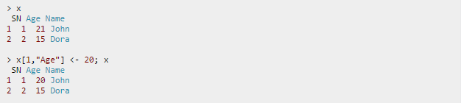
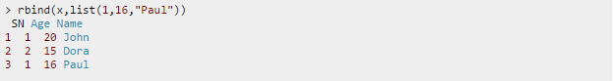
R Programming – R Data Frame
How to modify a Data Frame in R?
Data frames can be modified like we modified matrices through reassignment.
Adding Components
Rows can be added to a data frame using the rbind() function.

Slide 57
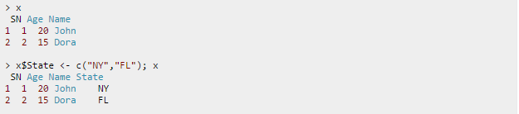
R Programming – R Data Frame
Similarly, we can add columns using cbind().
Since data frames are implemented as list, we can also add new columns through simple list-like assignments.

Slide 58


R Programming – R Data Frame
Deleting Component
Data frame columns can be deleted by assigning NULL to it.
Similarly, rows can be deleted through reassignments.

Slide 59

R Programming – R Factors
Factor is a data structure used for fields that takes only predefined, finite number of values (categorical data).
For example, a data field such as marital status may contain only values from single, married, separated, divorced, or widowed.
In such case, we know the possible values beforehand and these predefined, distinct values are called levels. Following is an example of factor in R.
Here, we can see that factor x has four elements and two levels. We can check if a variable is a factor or not using class() function.
Similarly, levels of a factor can be checked using the levels() function.

Slide 60

R Programming – R Factors
How to create a factor in R?
We can create a factor using the function factor(). Levels of a factor are inferred from the data if not provided.
We can see from the above example that levels may be predefined even if not used.
Factors are closely related with vectors. In fact, factors are stored as integer vectors. This is clearly seen from its structure.

Slide 61
R Programming – R Factors
Factor is a data structure used for fields that takes only predefined, finite number of values (categorical data).
For example, a data field such as marital status may contain only values from single, married, separated, divorced, or widowed.
In such case, we know the possible values beforehand and these predefined, distinct values are called levels. Following is an example of factor in R.
Here, we can see that factor x has four elements and two levels. We can check if a variable is a factor or not using class() function.
Similarly, levels of a factor can be checked using the levels() function.

Slide 62
R Programming – R Factors
We see that levels are stored in a character vector and the individual elements are actually stored as indices.
Factors are also created when we read non-numerical columns into a data frame.
By default, data.frame() function converts character vector into factor. To suppress this behavior, we have to pass the argument stringsAsFactors = FALSE.

Slide 63

R Programming – R Factors
How to access components of a factor?
Accessing components of a factor is very much similar to that of vectors.

Slide 64

R Programming – R Factors
How to modify a factor?
Components of a factor can be modified using simple assignments. However, we cannot choose values outside of its predefined levels.

Slide 65

R Programming – R Lists
List is a data structure having components of mixed data types.
A vector having all elements of the same type is called atomic vector but a vector having elements of different type is called list.
We can check if it's a list with typeof() function and find its length using length().
Following is an example of a list having three components each of different data type.

Slide 66

R Programming – R Lists
How to access components of a list?
Lists can be accessed in similar fashion to vectors. Integer, logical or character vectors can be used for indexing. Let us consider a list as follows.

Slide 67

R Programming – R Lists
How to modify a list in R?
We can change components of a list through reassignment. We can choose any of the component accessing techniques discussed above to modify it.
Notice below that modification causes reordering of components.

Slide 68

R Programming – R Lists
How to add components to a list?
Adding new components is easy. We simply assign values using new tags and it will pop into action.

Slide 69
R Programming – Useful functions
Function | Description
ls() | List of Data objects in memory
rm(object) | Remove an object from memory
length(object) | Number of elements in a vector
str(object) | Details about structure of an object
class(object) | What type of object
dim(object) | Number of rows and columns in a data frame or a matrix
data() | List of data sets available in different loaded packages

Slide 70
R Programming – Useful functions
Function | Description
mean (x) | Average of vector of numbers
var(x), sd(x) | Variance and Standard Deviation
median(x) | Median
range(x) | Minimum and Maximum numbers
sum(x) | Sum of a vector of numbers
min(x), max(x) | Minimum, Maximum
quantile(x, prob) | Values of x at different percentiles

Slide 71
R Programming – Loop functions
Looping on the Command Line
Writing for and while loops is useful when programming but not particularly easy when working interactively on the command line.
Multi-line expressions with curly braces are just not that easy to sort through when working on the command line.
R has some functions which implement looping in a compact form to make your life easier.
• lapply(): Loop over a list and evaluate a function on each element
• sapply(): Same as lapply but try to simplify the result
• apply(): Apply a function over the margins of an array
• tapply(): Apply a function over subsets of a vector
• mapply(): Multivariate version of lapply
An auxiliary function split is also useful, particularly in conjunction with lapply.

Slide 72
R Programming – apply()
The apply() Family
The apply() family pertains to the R base package and is populated with functions to manipulate slices of data from matrices, arrays, lists and dataframes in a repetitive way.
These functions allow crossing the data in a number of ways and avoid explicit use of loop constructs.
They act on an input list, matrix or array and apply a named function with one or several optional arguments.
The called function could be:
An aggregating function, like for example the mean, or the sum (that return a number or scalar);
Other transforming or subsetting functions; and
Other vectorized functions, which return more complex structures like lists, vectors, matrices and arrays.

Slide 73
R Programming – apply()
The apply() functions form the basis of more complex combinations and helps to perform operations with very few lines of code. More specifically, the family is made up of the apply(), lapply() , sapply(), vapply(), mapply(), rapply(), and tapply() functions.
How To Use apply() in R
apply(X, MARGIN, FUN, ...)
where:
X is an array or a matrix if the dimension of the array is 2;
MARGIN is a variable defining how the function is applied: when MARGIN=1, it applies over rows, whereas with MARGIN=2, it works over columns. Note that when you use the construct MARGIN=c(1,2), it applies to both rows and columns; and
FUN, which is the function that you want to apply to the data. It can be any R function, including a User Defined Function (UDF).

Slide 74
R Programming – lapply()
Looping on the Command Line
Writing for and while loops is useful when programming but not particularly easy when working interactively on the command line.
Multi-line expressions with curly braces are just not that easy to sort through when working on the command line.
R has some functions which implement looping in a compact form to make your life easier.
• lapply(): Loop over a list and evaluate a function on each element
• sapply(): Same as lapply but try to simplify the result
• apply(): Apply a function over the margins of an array
• tapply(): Apply a function over subsets of a vector
• mapply(): Multivariate version of lapply
An auxiliary function split is also useful, particularly in conjunction with lapply.

Slide 75
R Programming – sapply()
The sapply() function behaves similarly to lapply(); the only real difference is in the return value.
sapply() will try to simplify the result of lapply() if possible. Essentially, sapply() calls lapply()
on its input and then applies the following algorithm:
• If the result is a list where every element is length 1, then a vector is returned
• If the result is a list where every element is a vector of the same length (> 1), a matrix is returned.
• If it can’t figure things out, a list is returned

Slide 76
R Programming – split()
The split() function takes a vector or other objects and splits it into groups determined by a factor or list of factors.
The arguments to split() are
> str(split)
function (x, f, drop = FALSE, ...)
where
x is a vector (or list) or data frame.
f is a factor (or coerced to one) or a list of factors
drop indicates whether empty factors levels should be dropped

Slide 77
R Programming – tapply()
tapply() is used to apply a function over subsets of a vector. It can be thought of as a combination of split() and sapply() for vectors only. I’ve been told that the “t” in tapply() refers to “table”, but that is unconfirmed.
> str(tapply)
function (X, INDEX, FUN = NULL, ..., simplify = TRUE)
The arguments to tapply() are as follows:
X is a vector
INDEX is a factor or a list of factors (or else they are coerced to factors)
FUN is a function to be applied
… contains other arguments to be passed FUN
simplify, should we simplify the result?

Slide 78
R Programming – Col/Row Sums and Means
For the special case of column/row sums and column/row means of matrices, we have some useful shortcuts.
• rowSums = apply(x, 1, sum)
• rowMeans = apply(x, 1, mean)
• colSums = apply(x, 2, sum)
• colMeans = apply(x, 2, mean)
The shortcut functions are heavily optimized and hence are much faster, but you probably won’t notice unless you’re using a large matrix. Another nice aspect of these functions is that they are a bit more descriptive. It’s arguably more clear to write colMeans(x) in your code than apply(x, 2, mean).

Slide 79
R Programming – mapply()
The mapply() function is a multivariate apply of sorts which applies a function in parallel over a set of arguments. Recall that lapply() and friends only iterate over a single R object. What if you want to iterate over multiple R objects in parallel? This is what mapply() is for.
> str(mapply)
function (FUN, ..., MoreArgs = NULL, SIMPLIFY = TRUE, USE.NAMES = TRUE)
The arguments to mapply() are
• FUN is a function to apply
• ... contains R objects to apply over
• MoreArgs is a list of other arguments to FUN.
• SIMPLIFY indicates whether the result should be simplified

Slide 80
Exploratory Data Analysis

Slide 81
Creating standard data summaries
1. Read the data from auto-mpg.csv and convert cylinders to factor:
auto <- read.csv("auto-mpg.csv", header = TRUE, stringsAsFactors = FALSE)
# Convert cylinders to factor
auto$cylinders <- factor(auto$cylinders, levels = c(3,4,5,6,8), labels = c("3cyl", "4cyl", "5cyl", "6cyl", "8cyl"))
2. Get the summary statistics:
summary(auto)
The summary() function gives a "six number" summary for numerical variables—minimum, first quartile, median, mean, third quartile, and maximum. For factors (or categorical variables), the function shows the counts for each level; for character variables, it just shows the total number of available values.

Slide 82
Creating standard data summaries
3.Using the str() function for an overview of a data frame :
str(auto)
The str() function gives a concise view into a data frame. In fact, we can use it to see the underlying structure of any arbitrary R object.
4. Computing the summary for a single variable :
summary(auto$cylinders)
summary(auto$mpg)
The summary you get for numerical variables remains as before, but for factors, you get counts for many more levels.
5.Finding the mean and standard deviation :
Use the functions mean() and sd() as follows:
mean(auto$mpg)
sd(auto$mpg)

Slide 83
Extracting a subset of a dataset
The following steps extract a subset of a dataset:
1.Index by position.
Get model_year and car_name for the first three cars:
auto[1:3, 8:9]
auto[1:3, c(8,9)]
2. Index by name.
Get model_year and car_name for the first three cars:
auto[1:3,c("model_year", "car_name")]
3.Retrieve all details for cars with the highest or lowest mpg, using the following code:
auto[auto$mpg == max(auto$mpg) | auto$mpg == min(auto$mpg),]

Slide 84
Extracting a subset of a dataset
3. Excluding columns
Use the minus sign for variable positions that you want to exclude from the subset. Also, you cannot mix both positive and negative indexes in the list. Both of the following approaches are correct:
auto[,c(-1,-9)]
auto[,-c(1,9)]
However, this subsetting approach does not work while specifying variables using names. For example, we cannot use –c("No", "car_name"). Instead, use %in% with ! (negation) to exclude variables:
auto[, !names(auto) %in% c("No", "car_name")]

Slide 85
Extracting a subset of a dataset
4. Selecting based on multiple values
Select all cars with mpg = 15 or mpg = 20:
auto[auto$mpg %in% c(15,20),c("car_name","mpg")]
5. Selecting using logical vector
You can specify the cases (rows) and variables you want to retrieve using boolean vectors. In the following example, R returns the first and second cases, and for each, we get the third variable alone. R returns the elements corresponding to TRUE:
auto[1:2,c(FALSE,FALSE,TRUE)]

Slide 86
Splitting a dataset
The split function divides data into groups based on a factor or vector. The unsplit() function reverses the effect of split.
carslist <- split(auto, auto$cylinders)
The split(auto, auto$cylinders) function returns a list of data frames with each data frame corresponding to the cases for a particular level of cylinders. To reference a data frame from the list, use the [ notation.

Slide 87
Visualization

Slide 88
Visualize Your Data
Visualization means creating charts and plots from the raw data.
Plots of the distribution or spread of attributes can help you spot outliers, strange or invalid data and give you an idea of possible data transformations you could apply.
Visualization Packages: A quick note about your options when it comes to R packages for visualization.
Univariate Visualization: Plots you can use to understand each attribute standalone.
Multivariate Visualization: Plots that can help you to better understand the interactions between attributes.

Slide 89

Histogram
hist(acceleration)
R determines the various properties of the generated graph (like bin sizes, axes scales, axes titles, chart title, bar colors,…) automatically. The following diagram shows the output of the preceding command:

Slide 90

Histogram
hist(acceleration, col="blue", xlab = "acceleration", main = "Histogram of acceleration", breaks = 15)

Slide 91

Boxplots
boxplot(mpg, xlab = "Miles per gallon")

Slide 92
Boxplots
boxplot(mpg, xlab = "Miles per gallon")

Slide 93


Slide 94

ML vs Statistics

Slide 95
Feature Selection

Slide 96
Common Data Problems
Noise: random error or variance in a measured variable
Extremely high quantity, rate and amount were eliminated from the data.
Negative discount values were eliminated from the data.
Missing data may be due to
Equipment malfunction
Consistent with other recorded data and thus deleted
Data not entered due to misunderstanding
Certain data may not be considered important at the time of entry
Not register history or changes of the data
Unified date format:
binary, nominal (categorical), ordinal, numeric
e.g. “Sep 24, 2003” , 9/24/03, 24.09.03, etc
Containing discrepancies in names
Other data problems which requires data cleaning
Duplicate records
Incomplete data
Inconsistent data

Slide 97
Understand Your Data Using Descriptive Statistics
Any machine learning models that you build are only as good as the data that you provide them. The ﬁrst step in understanding your data is to actually look at some raw values and calculate some basic statistics.
Data Cleaning : You may discover missing or corrupt data and think of various data cleaning operations to perform such as marking or removing bad data and imputing missing data.
Data Transforms : You may discover that some attributes have familiar distributions such as Gaussian or exponential giving you ideas of scaling or other transforms you could apply.
Data Modeling : You may notice properties of the data such as distributions or data types that suggest the use (or to not use) speciﬁc machine learning algorithms.

Slide 98
Feature Selection
Feature selection is also called variable selection or attribute selection.
It is the automatic selection of attributes in your data (such as columns in tabular data) that are most relevant to the predictive modeling problem you are working on.
Feature Selection Algorithms
Filter Methods
Some examples of some filter methods include the Chi squared test, information gain and correlation coefficient scores.
Wrapper Methods
A predictive model us used to evaluate a combination of features and assign a score based on model accuracy.
Embedded Methods
Examples of regularization algorithms are the LASSO, Elastic Net and Ridge Regression.

Slide 99

Class Distribution
A frequency distribution is a table or graph that displays the frequency of various outcomes in a sample.
Each entry in the table contains the frequency or count of the occurrences of values within a particular group or interval, and in this way, the table summarizes the distribution of values in the sample.
Calculate class breakdown
Output class breakdown

Slide 100
Data Summary
In descriptive statistics, summary statistics are used to summarize a set of observations, in order to communicate the largest amount of information as simply as possible.
Numerical attributes are described using the properties:
Min
25th percentile
Median
Mean
75th percentile
Max
The breakdown also includes an indication of the number of missing values for an attribute (marked N/A).

Slide 101


Data Summary
Calculate the summary of the attributes.
Output of the summary of attributes.

Slide 102

Standard Deviation
The standard deviation(SD) is a measure that is used to quantify the amount of variation or dispersion of a set of data values.
A low standard deviation indicates that the data points tend to be close to the mean (also called the expected value) of the set, while a high standard deviation indicates that the data points are spread out over a wider range of values.

Slide 103

Standard Deviation

Slide 104


Standard Deviation
The standard deviation along with the mean are useful to know if the data has a Gaussian (or nearly Gaussian) distribution.
It can be useful for a quick and dirty outlier removal tool, where any values that are more than three times the standard deviation from the mean are outside of 99.7% of the data.
Calculate standard deviations.

Slide 105

Skewness
Skewness is a measure that refers to the extent of symmetry or asymmetry in a distribution.
Skewness is asymmetry in a statistical distribution, in which the curve appears distorted or skewed, either to the left or to the right.
Skewness can be quantified to define the extent to which a distribution differs from a normal distribution.

Slide 106


Skewness
If a distribution looks nearly-Gaussian but is pushed far left or right it is useful to know the skew.
Getting a feeling for the skew is much easier with plots of the data, such as a histogram or density plot. It is harder to tell from looking at means, standard deviations and quartiles.
Calculate Skewness

Slide 107


Correlations
Correlation is a statistical technique that can show whether and how strongly pairs of variables are related.
The main result of a correlation is called the correlation coefficient (or "r"). It ranges from -1.0 to +1.0. The closer r is to +1 or -1, the more closely the two variables are related.

Slide 108

Correlations
For numeric attributes, an excellent way to think about attribute-to-attribute interactions is to calculate correlations for each pair of attributes.
Calculate Correlations

Slide 109

Correlations contd...
This creates a symmetrical table of all pairs of attribute correlations for numerical data.
Deviations from zero show more positive or negative correlation. Values above 0.75 or below -0.75 are perhaps more interesting as they show a high correlation or high negative correlation.
Values of 1 and -1 show full positive or negative correlation.
Output of Correlations

Slide 110
Data Pre-Processing

Slide 111
Data Pre-Processing in R
The caret package in R provides a number of useful data transforms. These transforms can be used in two ways:
Standalone :
Transforms can be modeled from training data and applied to multiple datasets. The model of the transform is prepared using the preProcess() function and applied to a dataset using the predict() function.
Training :
Transforms can be prepared and applied automatically during model evaluation. Transforms applied during training are prepared using the preProcess() and passed to the train() function via the preProcess argument.

Slide 112
Data Pre-Processing in R contd...
Below is a quick summary of all of the transform methods supported in the argument to the preProcess() function in caret.
BoxCox | apply a Box-Cox transform, values must be non-zero and positive.
YeoJohnson | apply a Yeo-Johnson transform, like a BoxCox, but values can be negative.
expoTrans | apply a power transform like BoxCox and YeoJohnson.
zv | remove attributes with a zero variance (all the same value).
nzv | remove attributes with a near zero variance (close to the same value).
center | divide values by standard deviation.
scale | subtract mean from values.
range | normalize values.
pca | transform data to the principal components.

Slide 113

Scale Data
The scale transform calculates the standard deviation for an attribute and divides each value by that standard deviation.
Calculate scale data transform.

Slide 114



Scale Data contd...
The scale transform calculates the standard deviation for an attribute and divides each value by that standard deviation.
Output of scale data transform.

Slide 115

Center Data
The center transform calculates the mean for an attribute and subtracts it from each value.
Calculate center data transform.

Slide 116

Center Data contd...
Output of center data transform.

Slide 117

Standardize Data
A standardized variable (sometimes called a z-score or a standard score) is a variable that has been re scaled to have a mean of zero and a standard deviation of one.
A standardized variable (Z) redefines each observation in terms of the number of standard deviations from the mean.

Slide 118

Standardize Data
Combining the scale and center transforms will standardize your data. Attributes will have a mean value of 0 and a standard deviation of 1.
Calculate standardize data transform.

Slide 119

Standardize Data contd...
Output standardize data transform.

Slide 120

Normalize Data
Data values can be scaled into the range of [0, 1] which is called normalization.
Calculate normalize data transform.

Slide 121

Normalize Data
Eliminates the unit of measurement by transforming the data into new scores with a mean of 0 and a standard deviation of 1.
Data values can be scaled into the range of [0, 1] which is called normalization.

Slide 122
Normalize Data
Calculate normalize data transform.

Slide 123

Normalize Data contd...
Output normalize data transform.

Slide 124


Box-Cox Transform
When an attribute has a Gaussian-like distribution but is shifted, this is called a skew. The distribution of an attribute can be shifted to reduce the skew and make it more Gaussian. The BoxCox transform can perform this operation (assumes all values are positive).
Calculate Box-Cox data transform.

Slide 125

Box-Cox Transform contd...
Output Box-Cox data transform.

Slide 126


Yeo-Johnson Transform
The YeoJohnson transform another power-transform like Box-Cox, but it supports raw values that are equal to zero and negative.
Calculate Yeo-Johnson data transform.

Slide 127

Yeo-Johnson Transform contd...
Output Yeo-Johnson data transform.

Slide 128


Principal Component Analysis Transform
The PCA transforms the data to return only the principal components, a technique form multivariate statistics and linear algebra.
The transform keeps those components above the variance threshold (default=0.95) or the number of components can be speciﬁed (pcaComp).
The result is attributes that are uncorrelated, useful for algorithms like linear and generalized linear regression.
Calculate PCA data transform.

Slide 129
Principal Component Analysis Transform
Principal component analysis (PCA) is a statistical procedure that uses an orthogonal transformation to convert a set of observations of possibly correlated variables into a set of values of linearly uncorrelated variables called principal components.
The PCA transforms the data to return only the principal components, a technique form multivariate statistics and linear algebra.
The transform keeps those components above the variance threshold (default=0.95) or the number of components can be specified (pcaComp).
The result is attributes that are uncorrelated, useful for algorithms like linear and generalized linear regression.

Slide 130

Principal Component Analysis Transform contd...
Output PCA data transform.

Slide 131


Slide 132

Supervised Learning
Supervised learning, in the context of artificial intelligence (AI) and machine learning, is a type of system in which both input and desired output data are provided. Input and output data are labelled for classification to provide a learning basis for future data processing.

Slide 133


Slide 134

Unsupervised Learning
Unsupervised learning is the training of an artificial intelligence (AI) algorithm using information that is neither classified nor labeled and allowing the algorithm to act on that information without guidance.

Slide 135

Semi - supervised Learning
Semi-supervised learning is a class of supervised learning tasks and techniques that also make use of unlabeled data for training – typically a small amount of labeled data with a large amount of unlabeled data.

Slide 136

Semi - supervised Learning

Slide 137

Reinforcement Learning
Reinforcement Learning is a type of Machine Learning, and thereby also a branch of Artificial Intelligence. It allows machines and software agents to automatically determine the ideal behavior within a specific context, in order to maximize its performance.

Slide 138

Reinforcement Learning

Slide 139

Data Split
Data splitting involves partitioning the data into an explicit training dataset used to prepare the model and an unseen test dataset used to evaluate the models performance on unseen data.
It is useful when you have a very large dataset so that the test dataset can provide a meaningful estimation of performance, or for when you are using slow methods and need a quick approximation of performance.

Slide 140
Model Evaluation Metrics

Slide 141
Accuracy and Kappa
Accuracy and Kappa are the default metrics used to evaluate algorithms on binary and multiclass classiﬁcation datasets in caret.
Accuracy is the percentage of correctly classiﬁed instances out of all instances. It is more useful on a binary classiﬁcation than multi-class classiﬁcation problem because it can be less clear exactly how the accuracy breaks down across those classes (e.g. you need to go deeper with a confusion matrix).
Kappa or Cohen’s Kappa is like classification accuracy, except that it is normalized at the baseline of random chance on your data set
Kappa is a more useful measure to use on problems that have an imbalance in the classes (e.g. a 70% to 30% split for classes 0 and 1 and you can achieve 70% accuracy by predicting all instances are for class 0).

Slide 142


Accuracy and Kappa contd...
Calculate Accuracy and Kappa metrics.
Output of Accuracy and Kappa metrics.

Slide 143
Metric Description Formula
Accuracy : what % of predictions were correct? (TP+TN)/(TP+TN+FP+FN)
Misclassification Rate : what % of prediction is wrong? (FP+FN)/(TP+TN+FP+FN)
True Positive Rate OR Sensitivity OR Recall (completeness) : what % of positive cases did model catch? TP/(FN+TP)
False Positive Rate : what % of 'No' were predicted as 'Yes'? FP/(FP+TN)
Specificity : what % of 'No' were predicted as 'No‘? TN/(TN+FP)
Precision (exactness) : what % of positive predictions were correct? TP/(TP+FP)
F1 score : Weighted average of precision and recall : 2*((precision * recall) / (precision + recall))

Slide 144
RMSE and R2
RMSE and R2 are the default metrics used to evaluate algorithms on regression datasets in caret.
RMSE or Root Mean Squared Error is the average deviation of the predictions from the observations. It is useful to get a gross idea of how well (or not) an algorithm is doing, in the units of the output variable.
R2 spoken as R Squared or also called the coefficient of determination provides a goodness of-ﬁt measure for the predictions to the observations. This is a value between 0 and 1 for no-ﬁt and perfect ﬁt respectively.

Slide 145


RMSE and R2 contd...
Calculate RMSE and RSquared metrics.
Output of RMSE and RSquared metrics.

Slide 146
Area Under ROC Curve
ROC metrics are only suitable for binary classification problems (e.g. two classes).
ROC is actually the area under the ROC curve or AUC. The AUC represents a models ability to discriminate between positive and negative classes.
Sensitivity is the true positive rate also called the recall. It is the number of instances from the positive (ﬁrst) class that actually predicted correctly.
Speciﬁcity is also called the true negative rate. Is the number of instances from the negative class (second class) that were actually predicted correctly.

Slide 147


Area Under ROC Curve contd...
Calculate ROC metrics.
Output ROC metrics.

Slide 148
Machine Learning Algorithms

Slide 149


Linear Regression

Slide 150

Linear Regression
The lm() function is in the stats package and creates a linear regression model using ordinary least squares.
Example of linear regression algorithm.

Slide 151


Linear Regression contd...
Example of linear regression algorithm in caret.

Slide 152

Logistic Regression
Logistic regression, or logit regression, or logit model is a regression model where the dependent variable (DV) is categorical.

Slide 153

Logistic Regression
The glm() function is in the stats package and creates a generalized linear model for regression or classification. It can be conﬁgured to perform a logistic regression suitable for binary classification problems.
Example of logistic regression algorithm.

Slide 154

Logistic Regression contd...
The glm algorithm can be used in caret as follows:
Example of logistic regression algorithm in caret.

Slide 155

Support Vector Machine
The ksvm() function is in the kernlab package and can be used for classiﬁcation or regression. It is a wrapper for the LIBSVM software package and provides a suite of kernel types and conﬁguration options. These examples uses a Radial Basis kernel.
Example of SVM algorithm for classiﬁcation.

Slide 156

Support Vector Machine contd...
Example of SVM algorithm for regression.

Slide 157

K-Means Clustering

Slide 158
K-Means Clustering Algorithm
Choose a number of clusters k – iterative method or standard algorithms.
Initialize cluster centers μ1,… μk
Could pick k data points and set cluster centers to these points.
Or could randomly assign points to clusters and take means of clusters.
For each data point, compute the cluster center it is closest to (using some distance measure) and assign the data point to this cluster.
Re-compute cluster centers (mean of data points in cluster).
Stop when there are no new re-assignments.

Slide 159
K-Means Clustering using R
#Loading data into memory - don't take the last column,as it has labels
sample.data<-iris[,-ncol(iris)]
summary(sample.data)
colnames(sample.data)
#K-Means Clustering
fit2 <- kmeans(sample.data, 3)
# get cluster means
Cluster.means<-aggregate(sample.data,by=list(fit2$cluster),FUN=mean)
# Total sum squares
Global.mean<-apply(sample.data,2, mean)
# Within sum squares
# Between Sum Squares

Slide 160

K-Means Clustering using R contd...

Slide 161

Visualization of K-Means Cluster - Results
Library(cluster)
Library(fpc)
Clus<-kmean(dat, centers=3)
Plotcluster(data, clus$center)
Uses Multidimensional scaling approach
Multiple features of data observations are mapped to two dimensions for easy visualization

Slide 162

Visualization of K-Means Cluster – Results contd...
Relationships among various variables based on clustered observations

Slide 163

Hierarchical Clustering
Build a tree-based hierarchical taxonomy (dendrogram) from a set of observations.
Clustering obtained by cutting the dendrogram at a desired level: each connected component forms a cluster
Agglomerative (bottom-up)
Divisive (top-down)
Start with each obs. being a single cluster
Eventually all observations belong to the same cluster
Start with all obs. belonging to the same cluster
Eventually each node forms a cluster on its own.

Slide 164



Hierarchical Clustering in R

Slide 165
Time Series

Slide 166
Time Series
A time series is a series of data points indexed (or listed or graphed) in time order. Most commonly, a time series is a sequence taken at successive equally spaced points in time.
Time series are very frequently plotted via line charts.
Time series are used in statistics, signal processing, pattern recognition, econometrics, mathematical finance, weather forecasting, earthquake prediction, electroencephalography, control engineering, astronomy, communications engineering, and largely in any domain of applied science and engineering which involves temporal measurements.
Time series analysis comprises methods for analyzing time series data in order to extract meaningful statistics and other characteristics of the data.
Time series forecasting is the use of a model to predict future values based on previously observed values.

Slide 167
Reading Time Series
We can specify the number of times that data was collected per year by using the ‘frequency’ parameter in the ts() function.
For monthly time series data, you set frequency=12, while for quarterly time series data, you set frequency=4.
We can also specify the ﬁrst year that the data was collected, and the ﬁrst interval in that year by using the ‘start’ parameter in the ts() function.
birthstimeseries <- ts(births, frequency=12, start=c(1946,1))

Slide 168
Decomposing Time Series
Decomposing a time series means separating it into its constituent components, which are usually a trend component and an irregular component, and if it is a seasonal time series, a seasonal component.
Decomposing Non-Seasonal Data
A non-seasonal time series consists of a trend component and an irregular component. Decomposing the time series involves trying to separate the time series into these components, that is, estimating the trend component and the irregular component.
To estimate the trend component of a non-seasonal time series that can be described using an additive model, it is common to use a smoothing method, such as calculating the simple moving average of the time series.

Slide 169
Decomposing Time Series
SMA() function
We can use the “SMA()” function to smooth time series data.
To use the SMA() function, you need to specify the order (span) of the simple moving average, using the parameter“n”.
We can try to estimate the trend component of this time series by smoothing using a simple moving average.
To estimate the trend component more accurately, we might want to try smoothing the data with a simple moving average of a higher order. This takes a little bit of trial-and-error, to ﬁnd the right amount of smoothing

Slide 170
Decomposing Seasonal Data
A seasonal time series consists of a trend component, a seasonal component and an irregular component.
Decomposing the time series means separating the time series into these three components: that is, estimating these three components.
To estimate the trend component and seasonal component of a seasonal time series that can be described using an additive model, we can use the “decompose()” function in R.
This function estimates the trend, seasonal, and irregular components of a time series that can be described using an additive model.
Seasonally Adjusting
A seasonal time series that can be described using an additive model, we can seasonally adjust the time series by estimating the seasonal component, and subtracting the estimated seasonal component from the original time series.

Slide 171
Simple Exponential Smoothing
If we have a time series that can be described using an additive model with constant level and no seasonality,you can use simple exponential smoothing to make short-term forecasts.
The simple exponential smoothing method provides a way of estimating the level at the current time point.
Smoothing is controlled by the parameter alpha; for the estimate of the level at the current time point. The value of alpha; lies between 0 and 1.
Values of alpha that are close to 0 mean that little weight is placed on the most recent observations when making forecasts of future values.
To make forecasts using simple exponential smoothing in R, we can ﬁt a simple exponential smoothing predictive model using the “HoltWinters()” function in R.

Slide 172
Simple Exponential Smoothing
To use HoltWinters() for simple exponential smoothing, we need to set the parameters beta=FALSE and gamma=FALSE in the HoltWinters() function (the beta and gamma parameters are used for Holt’s exponential smoothing, or Holt-Winters exponential smoothing).
The HoltWinters() function returns a list variable, that contains several named elements.
As a measure of the accuracy of the forecasts, we can calculate the sum of squared errors for the in-sample forecast errors, that is, the forecast errors for the time period covered by our original time series.
The sum-of squared-errors is stored in a named element of the list variable called “SSE”

Slide 173
Simple Exponential Smoothing
If we have a time series that can be described using an additive model with constant level and no seasonality,you can use simple exponential smoothing to make short-term forecasts.
The simple exponential smoothing method provides a way of estimating the level at the current time point.
Smoothing is controlled by the parameter alpha; for the estimate of the level at the current time point. The value of alpha; lies between 0 and 1.
Values of alpha that are close to 0 mean that little weight is placed on the most recent observations when making forecasts of future values.

Slide 174
Classification Models

Slide 175
Classification Examples
An emergency room measures a patient’s vital signs such as blood pressure, respiratory rate, pulse, etc.)
Problem: to predict high-risk patients and discriminate them from low-risk patients which can help to put a patient to ICU.
A financial credit can be approved to only financial worthy customers.
Problem: to decide whether an application should approved or not based on data such as age, job profession, earning capacity, previous barrowing history etc.
Advertisers get $$ for display ads only if users click them.
Problem: Predict whether a user clicks a mobile display if by considering various ad parameters such as number of works, pictures, message etc.

Slide 176
Introduction to Classification Models
Classification models aims to identify the class to which new observations belong, on the basis of a training set of data containing observations whose class is known.
It includes many techniques for modeling and analyzing several variables, when the focus is on the relationship between a Categorical dependent variable and one or more independent variables (can be numerical or categorical)
Classification problems are widely applicable in real world scenarios
DEFINITIONS & CONCEPTS
EXAMPLE 1
EXAMPLE 2
Whether or not a patient is cured of a disease, given the time of treatment, the dosage of medicine
Whether someone will default the loan or repay depends on his Credit history, repayment capacity etc.

Slide 177
Predictive Modeling Techniques for Classification Problems
Objective
Predictive modeling is the analysis of data objects and identification of relationships among these data objects in a business context. Modeling involves finding good subsets of predictors or explanatory variables for a given ‘event’.
Few Modeling Techniques
Linear Regression
Logistics Regression
Discriminant analysis
Artificial Neural Network
Support Vector Machines
Decision Trees
Random Forests
Boosting Trees
K-Nearest Neighbor
Bayesian networks
Bagging Methods
Hidden Markov Models

Slide 178
K Nearest Neighbors

Slide 179

K Nearest Neighbors: Introduction
Learning by analogy -Tell me who your friends are and I’ll tell you who you are
A new example is assigned to the most common class among the (K) examples that are most similar to it
No model is built: Store all training examples

Slide 180

K Nearest Neighbors: Algorithm
To determine the class of a new example E:
Calculate the distance between E and all examples in the training set
Select K-nearest examples to E in the training set - “Closeness” is defined in terms of the Euclidean distance between two examples
Assign E to the most common class among its K-nearest neighbors

Slide 181
K Nearest Neighbors: Strengths & Limitations
Strengths
Simple to implement & Use
Comprehensive – easy to explain and predict
Robust to noisy data by averaging k-nearest neighbors
Weakness
Need a lot of space to store all examples
Takes more time to classify a new example than with a model
Normalization of variables necessary

Slide 182
R example: K Nearest Neighbors
## prepare training data and label vector
train <- iris[-nrow(iris),-ncol(iris)]
cl <- iris[-nrow(iris),ncol(iris)]
# the object to be classified
test <-iris[nrow(iris),-ncol(iris)]
#installing and loading relevant package
install.packages("class")
library(class)
# call knn() and get its summary
summary(knn(train, test, cl, k = 20))

Slide 183

What is Support Vector Machine?
“Support Vector Machine” (SVM) is a supervised machine learning algorithm which can be used for both classification or regression challenges.
However, it is mostly used in classification problems. In this algorithm, we plot each data item as a point in n-dimensional space (where n is number of features you have) with the value of each feature being the value of a particular coordinate.
Then, we perform classification by finding the hyper-plane that differentiate the two classes very well (look at the below snapshot).
Support Vectors are simply the co-ordinates of individual observation. Support Vector Machine is a frontier which best segregates the two classes (hyper-plane/ line).

Slide 184

How does it work?
Identify the right hyper-plane (Scenario-1): Here, we have three hyper-planes (A, B and C). Now, identify the right hyper-plane to classify star and circle.
You need to remember a thumb rule to identify the right hyper-plane: “Select the hyper-plane which segregates the two classes better”. In this scenario, hyper-plane “B” has excellently performed this job.

Slide 185

How does it work?
Identify the right hyper-plane (Scenario-2): Here, we have three hyper-planes (A, B and C) and all are segregating the classes well. Now, How can we identify the right hyper-plane?
Here, maximizing the distances between nearest data point (either class) and hyper-plane will help us to decide the right hyper-plane. This distance is called as Margin. Let’s look at the below snapshot:

Slide 186

How does it work?
Here, we can see that the margin for hyper-plane C is high as compared to both A and B. Hence, we name the right hyper-plane as C.
Another lightning reason for selecting the hyper-plane with higher margin is robustness.
If we select a hyper-plane having low margin then there is high chance of miss-classification.

Slide 187

How does it work?
Identify the right hyper-plane (Scenario-3):
Some of you may have selected the hyper-plane B as it has higher margin compared to A. But, here is the catch, SVM selects the hyper-plane which classifies the classes accurately prior to maximizing margin.
Here, hyper-plane B has a classification error and A has classified all correctly. Therefore, the right hyper-plane is A.

Slide 188

How does it work?
Can we classify two classes (Scenario-4)?: Here, I am unable to segregate the two classes using a straight line, as one of star lies in the territory of other(circle) class as an outlier.
As already mentioned, one star at other end is like an outlier for star class.
SVM has a feature to ignore outliers and find the hyper-plane that has maximum margin. Hence, we can say, SVM is robust to outliers.

Slide 189

How does it work?
Find the hyper-plane to segregate to classes (Scenario-5): In the scenario below, we can’t have linear hyper-plane between the two classes, so how does SVM classify these two classes? Till now, we have only looked at the linear hyper-plane.
As already mentioned, one star at other end is like an outlier for star class.
SVM has a feature to ignore outliers and find the hyper-plane that has maximum margin. Hence, we can say, SVM is robust to outliers.

Slide 190

How does it work?
SVM can solve this problem. Easily! It solves this problem by introducing additional feature. Here, we will add a new feature z=x^2+y^2. Now, let’s plot the data points on axis x and z:
All values for z would be positive always because z is the squared sum of both x and y
In the original plot, red circles appear close to the origin of x and y axes, leading to lower value of z and star relatively away from the origin result to higher value of z.

Slide 191
How does it work?
In SVM, it is easy to have a linear hyper-plane between these two classes.
SVM has a technique called the kernel trick. These are functions which takes low dimensional input space and transform it to a higher dimensional space i.e. it converts not separable problem to separable problem, these functions are called kernels.
It is mostly useful in non-linear separation problem. Simply put, it does some extremely complex data transformations, then find out the process to separate the data based on the labels or outputs you’ve defined.

Slide 192

How does it work?
When we look at the hyper-plane in original input space it looks like a circle:

Slide 193
How does it work?
When we look at the hyper-plane in original input space it looks like a circle:
kernel: we have various options available with kernel like, “linear”, “rbf”,”poly” and others (default value is “rbf”). Here “rbf” and “poly” are useful for non-linear hyper-plane.
gamma: Kernel coefficient for ‘rbf’, ‘poly’ and ‘sigmoid’. Higher the value of gamma, will try to exact fit the as per training data set i.e. generalization error and cause over-fitting problem.
C: Penalty parameter C of the error term. It also controls the trade off between smooth decision boundary and classifying the training points correctly.

Slide 194

How does it work?
When we look at the hyper-plane in original input space:
In such cases, we do not see a straight line frontier directly in current plane which can serve as the SVM.
In such cases, we need to map these vector to a higher dimension plane so that they get segregated from each other.

Slide 195

How does it work?
Each of the green square in original distribution is mapped on a transformed scale. And transformed scale has clearly segregated classes.

Slide 196
Advantages of SVM
SVM performs well in case of non-linear separable data using kernel trick.
It works well in high dimensional space (i.e. large number of predictors)
It works well in case of text or image classification.
It does not suffer multicollinearity problem
Disadvantages of SVM
It takes a lot of time on large sized data sets
It does not directly return probability estimates.
The linear kernel is almost similar to logistic regression in case of linear separable data.

Slide 197
DECISION TREES

Slide 198
Introduction to Decision Tree Models
Building a single model considering all data observations may not give better predictive accuracy
Splitting data into multiple subsets and building separate models for each subset can help improve overall accuracy
Decision tree models help to identify the criteria to split the data in such a way to get the information gain (i.e. improvement in model accuracy)
The split criteria can be used as business rules and choose the right model for prediction

Slide 199



Suitable Conditions for Playing Golf
Would you make a Random choice of conditions or be more Analytical ??

Slide 200
Information Gain - Example
Play Golf |  | Playing Golf | Decision | # of Correct Decisions
YES | NO
9 | 5 | 9/14 | YES | 9
No Criteria - 9 Correct
VS
Outlook criteria - 10 Correct
Improvement in number of correct decisions = 1
 |  | Play Golf |  | Playing Golf | Decision | # of Correct Decisions
 |  | YES | NO
OUTLOOK | Sunny | 3 | 2 | 3/5 | YES | 3
 | Overcast | 4 | 0 | 4/4 | YES | 4
 | Rainy | 2 | 3 | 2/5 | NO | 3

Slide 201


Some Hints for Analytical Minds
We should select an attribute to split the data in a way that we get maximum improvement in model accuracy
Error or disorder need to be reduced so that better decision making can be achieved
Information Gain is the expected reduction in disorder (measured through Entropy) caused by partitioning the data according to the given attribute
$IG\left(T,a\right)=H\left(T\right)−H(T|a)$, where
$H\left(T\right) \& H\left(T | a\right)$ are model accuracies without and with attributes
$IG\left(T,a\right)$ Information gain achieved with attribute $a$

Slide 202


Entropy - Measuring Information Gain
Constructing a Decision tree is all about Information Gain - finding attribute that returns the highest information gain (i.e., the most homogeneous branches)
Change in Entropy is a Measure of Information Gain
If the sample is completely homogeneous the entropy is zero and if the sample is equally divided it has entropy of one.
$$entropy\left(A\right)=−\sum_{k=1}^{m}{p_{k}\log_{2}{(p_{k})}}$$

Slide 203

Information Gain & Decision Trees
A Decision Tree is a graphical representation of a sequence of Attributes that narrow down to a right model (e.g. decision to play or not-Play Golf)
The narrow down is achieved using the criterion of Information Gain

Slide 204
Decision Tree Terminologies
Root of Tree: Decision model based on entire data
Node: Decision model on subset of data based on split criteria
Typically a split criteria splits a node into two child nodes
Terminal Node: No further splitting of a node.
Models from terminal nodes are used for prediction
Path from root to a terminal node indicates a business rule
For prediction which ever business rule is satistified that particular model is used
1 = root node
= terminal node
= Intermediate node

Slide 205
Building a Decision Tree
Building a decision tree recursively splitting tree
Stop criteria – no further splitting of data (less number of observations or information gain is less than threshold
Information gain for each attribute at a node is derived using entropy criteria.
For a splitting data at a node, identify an attribute that gives maximum information gain.

Slide 206


Entropy Calculations During Each Split
To build a decision tree, we need to calculate two types of entropy using frequency tables
Entropy using the frequency table of one attribute:
Entropy using the frequency table of two attributes:

Slide 207


Information Gain Calculations for Each Attribute
Derive information gain for each of the attributes
An attribute information gain = Entropy of node – Entropy given attribute
The result is the Information Gain, or decrease in entropy

Slide 208


Identify an Attribute to Split a Node
Choose attribute with the largest information gain as the criteria for splitting a node

Slide 209


Build Decision Tree
Recursively partition the nodes to achieve improvements to models accuracy
To decide if it’s a node requires further splitting, use the following criteria
Number of observations in a node is more than threshold
Information gain achieved from a split is more than the threshold
Further split required
No further split needed

Slide 210

Output: Decision Tree to Decision Rules
A decision tree can easily be transformed to a set of rules by mapping from the root node to the leaf nodes one by one

Slide 211
Different Tree building Algorithms
ID3 (Iterative Dichotomiser 3)
C4.5 (successor of ID3)
CART (Classification And Regression Tree)
CHAID (CHi-squared Automatic Interaction Detector). Performs multi-level splits when computing classification trees
MARS: extends decision trees to handle numerical data better
Conditional Inference Trees. Statistics-based approach that uses non-parametric tests as splitting criteria, corrected for multiple testing to avoid overfitting. This approach results in unbiased predictor selection and does not require pruning

Slide 212
3 Steps for Choosing Right Decision Tree in CART
Tree growing
Splitting rules to generate tree
Stopping criteria: how far to grow?
Missing values: using surrogates
Tree pruning
Trimming off parts of the tree that don’t work
Ordering the nodes of a large tree by contribution to tree accuracy … which nodes come off first?
Optimal tree selection
Deciding on the best tree after growing and pruning
Balancing simplicity against accuracy

Slide 213

Decision Trees: R example
#DECISION TREES
install.packages("rpart")
library(rpart)
# grow tree
fit <- rpart(Kyphosis ~ Age + Number + Start, method="class", data=kyphosis)
printcp(fit) # display the results
plotcp(fit) # visualize cross-validation results
summary(fit) # detailed summary of splits

Slide 214

Decision Trees: R example
# plot tree
plot(fit, uniform=TRUE, main="Classification Tree for Kyphosis")
text(fit, use.n=TRUE, all=TRUE, cex=.8)

Slide 215
Decision Trees Strengths and Weekness
No assumptions are required about the distribution of data.
The explanatory variables can be a mixture of categorical, interval and continuous.
Especially good for missing variables, high-dimensional or large data sets.
Produce useful results by using a few important variables.
Unaffected by outliers, collinearities or heteroscedascity.
Results are easy to interpret.
An important weakness: Not based on a probabilistic model, no confidence interval.

Slide 216
Ensemble Methods

Slide 217



Who Can Win?
Einstein or the crowd sourcing
Ask an Expert
Audience Poll

Slide 218
Condorcet’s Jury Theorem
Marquis de Condorcet
French philosopher, mathematician, and political scientist

Slide 219

Ensemble Modelling
N GOOD MODELS
SINGLE PREDICTION
Multiple Models used together provide better predictive performance than could be obtained from any of the constituent single models

Slide 220

Why Combining Models Work?
Suppose there are 25 base classifiers
Each classifier has error rate, ε = 0.35
Assume independence among classifiers (i.e. probability of a classifier making mistake doesn’t influence other classifiers mistakes)
Probability that the ensemble classifier makes a wrong prediction
Ensemble makes a mistake only if majority of classifiers make mistakes (i.e. 13 out of 25 classifiers make a mistake)
The probability that 13 or more classifiers make error is (based on binomial distribution)
$$\sum_{k=13}^{25}{{\left(\begin{matrix}25 \\ i\end{matrix}\right)α}^{k}{(1−α)}^{25−k}}=0.06$$

Slide 221
Ensemble Classifiers
IDEA
Single classifier won’t give the best performance
Utilize multiple classifiers to improve accuracy
MOTIVATION
reduce variance: Multiple models can capture variations in distributions along various data segments
reduce bias: a combination of multiple classifiers can learn the underlying complexities than a single classifier
KEY STEP
Derive an ensemble of diverse classifiers from a single training set using samples of subsets of data.

Slide 222
Ensemble Modelling Approaches
Bagging Models – Build multiple models based on multiple subsets of sampled data (Breiman, 1994)
Boosting Models – Building classifiers by considering higher weights for incorrectly classified sample (Freund and Schapire 1995, Friedman et al. 1998)
Gradient Boosting Trees – Apply boosting models to classification or regression trees
Random Forests – Build a forest of decision trees (Breiman 2001)

Slide 223
Bagging and Boosting

Slide 224
Bagging - Ideas
Generate multiple datasets
Generate multiple subsets of data using sampling with replacement (aka bootstrapping)
Build multiple classifiers
For each subset of data, build a classifier
Classification
In case of categorical response variable, assign a class that has most number of votes from all classifiers
In case of continuous response variable, average from all classification models

Slide 225

Bag of Decision Trees - Example

Slide 226

Accuracy Improvement from Bagging Models

Slide 227
Useful Scenarios for Using Bagging Models
When Learning algorithm is unstable: if small changes to the training set cause large changes in the learned classifier.
If the learning algorithm is unstable, then Bagging model generally improves performance
Some candidate models that can used in bagging approach:
Decision tree, generalized linear regression, SVMs, Neural Networks etc.

Slide 228
Boosting Ideas
Two Key Ideas
New classifier models focus on misclassified samples of earlier classifiers
Each classifier is weighed based on misclassifications errors
How Boosting Algorithm Works?
Perform multiple iterations resulting in multiple classifiers
In each iteration, update the weights of examples by assigning higher weights to misclassified examples. This ensures that they become important in subsequent iterations
Combine results of all iterations (classifiers ) weighed by their errors

Slide 229

Boosting Algorithm Explained
Initialize example weights $w_{i}=1/N$
For $m=1⋯M$, $\# M$ is the number of iterations
Sample the classifier based on example weights
Learn the classifier $C_{m}$ using the sampled subset of data
Total weighed error estimate $err_{m}=\frac{\sum{w_{i} of all incorrect examples}}{\sum{w_{i} of all examples}}$
Classifier weight $α_{m}=\frac{1}{2}log⁡(\frac{1−err_{m}}{err_{m}})$
Update weights of all examples as:
Correctly classified examples $w_{i}=w_{i}e^{−α_{m}}$
Incorrectly classified examples $w_{i}=w_{i}e^{α_{m}}$
Normalize the weights $w_{i}$ so that they sum to 1
Prediction for test examples
Try all classifiers $C_{m}$ and choose the class that with highest sum of weights $α_{m}.$

Slide 230




Boosting Example
$$ε_{1}=0.3$$
$α_{1}$=.42
$$ε_{2}=.21$$
$$α_{2}=.65$$
$$ε_{3}=0.14$$
$$α_{3}=.92$$

Slide 231





Final Classifier Model
Final Classifier

Slide 232





AdaBoost (Freund and Schpaire)
Initialization
Iteration
Where error of h_{t} sum of weights of misclassified instances
Learn Model h_{t}
Final Output

Slide 233




Training Error
Interestingly there is proven bound on improvement after each iteration-

Slide 234


Test Error
What is expected

Slide 235





Slide 237
Random Forest

Slide 238
Introduction to Random Forests
Random Forests – AN ensemble method consisting of bagging of decision trees with randomized selection of attributes at each split
First randomization is bagging with a combination of learners based on bootstrapped samples
Second randomization to choose random subset of features for each split.
Final prediction is based on mean prediction (for regression problems) or class with maximum votes (for classification problems)

Slide 239

Random Forests
First randomization - Bootstrap samples
Second randomization: Random selection of K<=p split variables

Slide 240

Random Forests – Bootstrap Samples

Slide 241
Random Forests – Bagging
Each Tree sees only a sample of training data and captures only a part of information
Build multiple weak trees which vote together to give resulting prediction

Slide 242


Random Forests – Random selection subset of Features
Select randomly subset features of size $\sqrt{number of features}$
Select the best split only using the subset of features

Slide 243

Random Forest Algorithm
Let $N_{trees}$be the number of trees to build
For each of $N_{trees}$iterations
Select a new bootstrap sample from training set
Grow an un-pruned tree on this bootstrap.
At each internal node, randomly select $m_{try}$predictors and determine the best split using only these predictors.
Do not perform cost complexity pruning. Save tree as is, along side those built thus far.
Output overall prediction as the average response (regression) or majority vote (classification) from all Individually trained trees

Slide 244

Practical Considerations of Random Forests
Splits are chosen according to a purity measure:
e.g. squared error (regression), Gini index or deviance (classification)
How to select $N_{trees}$?
Build trees until the error no longer decreases
How to select $m_{try}$?
Try the recommended defaults, half of them and twice them and pick the best

Slide 245

Estimation of Test Error During Training
While growing forest, estimate test error from training samples
For each tree grown, about 1/3rd of samples are not selected in bootstrap, called out of bootstrap (OOB) samples
Using OOB samples as input to the corresponding tree, predictions are made as if they were novel test samples
Through book-keeping, majority vote (classification), average (regression) is computed for all OOB samples from all trees.
Such estimated test error is very accurate in practice, with reasonable $N_{trees}$

Slide 246

Estimating Importance of Each Feature
Denote$ê$ the OOB estimate of the loss when using original training set, $D$.
For each feature $x_{p}$where $p∈\{1,..,k\}$
Randomly permute $p^{th}$predictor to generate a new set of
samples $D′ =\{(y1,x′1),…,(yN,x′N)\}$
Compute OOB estimate $ê_{k}$ of prediction error with the new samples
A measure of importance of predictor $x_{p}$ is$ê_{k}$$– ê$, the increase in error due to random perturbation of $p^{th}$predictor

Slide 247

Estimating the Similarity of the Samples
During growth of the forest
Keep track of the number of times, samples $x_{i}$and $x_{j}$
appear in the same terminal node
Normalize by $N_{trees}$
Store all normalized co-occurrences in a matrix, denoted as the proximity matrix.
Proximity matrix can be considered a kind of similarity measure between any two samples $x_{i}$and $x_{j}$
Can even use a clustering method to perform unsupervised learning from Random Forests

